Slide 1
A Catholic introduction to artificial intelligence Class 1 lecture
Home School Connections
Instructor – Mr. Dan Goddu, BSCS LSSBB CIAAI-JHU

Slide 2
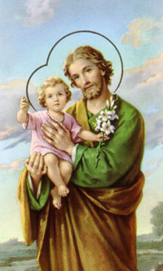
Opening Prayer
O Glorious St. Joseph, model of all those who are devoted to labor, obtain for me the grace to work conscientiously, putting the call of duty above my natural inclinations; to work with gratitude and joy, in a spirit of penance for the remission of my sins, considering it an honor to employ and develop by means of labor the gifts received from God; to work with order, peace, moderation, and patience, without ever shrinking from weariness and difficulties; to work above all with purity of intention and detachment from self, having always death before my eyes and the account that I must render of time lost, of talents wasted, of good omitted, of vain complacency in success, so fatal to the work of God. All for Jesus, all through Mary, all after thine example, O Patriarch, St. Joseph. Such shall be my motto in life and in death. Amen.

Slide 3
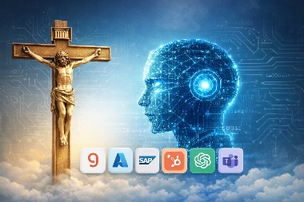
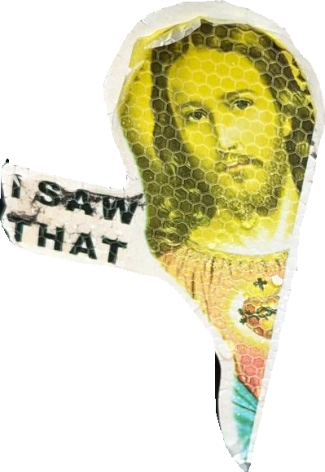
What you will learn in this class
Understand the course structure and expectations.
Define Artificial Intelligence (AI) in our own words.
Distinguish between AI, Machine Learning (ML), and Deep Learning (DL).
Identify examples of AI in their daily lives.
Begin to think critically about what AI is and what it is not.

Slide 4
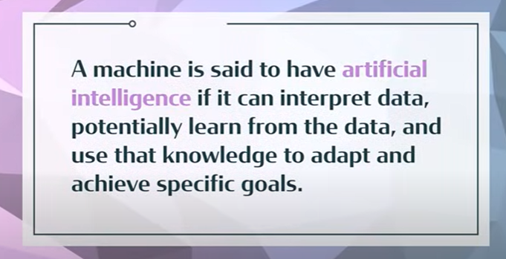
What is AI?
Artificial intelligence is an ever-expanding branch of computer science that focuses on making machines capable of performing tasks that usually require human intelligence, such as “reasoning”, solving problems, making decisions, “perceiving the world”, making meaning, and learning from experience.

Slide 5
The Big Picture of AI
Predictive analytics (forecasting sales, risk, fraud)
Recommendation systems (Netflix, Amazon)
Computer vision (medical imaging, self-driving cars)
Robotics
Speech recognition
Search & ranking
Optimization systems
Generative

Slide 6
most AI in the world is
Fraud detection systems
Logistics optimization
Supply chain modeling
Ad targeting
Industrial automation
Risk scoring
Credit models
Manufacturing control systems

Slide 7
Types of ai by market share

Slide 8
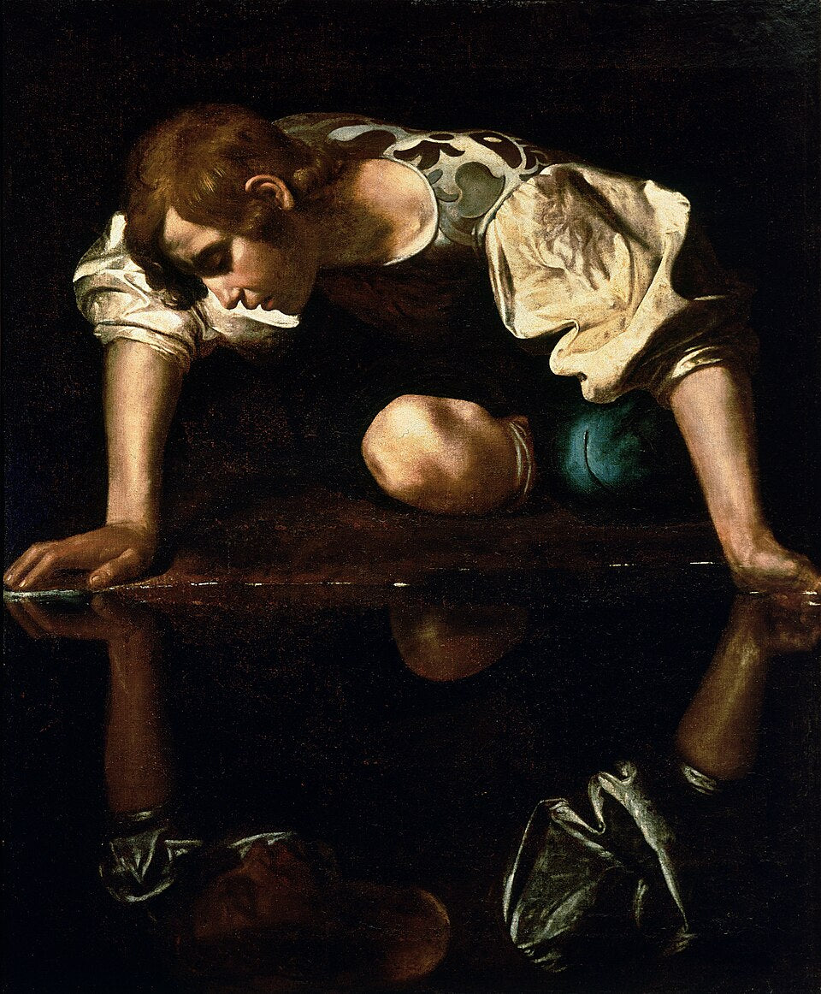
Self-Awareness
Self-awareness refers to the ability to have a clear and accurate understanding of your thoughts, feelings, values, strengths, weaknesses, motivations, and behaviors. It involves being able to observe yourself from outside, recognizing your patterns, habits, and emotions, and making conscious choices about how you want to present yourself to the world.

Slide 9
Where Is AI Being Used Today?
https://www.youtube.com/watch?v=4ocBFGtukow
Notes:
Generative pre-trained transformer

Slide 10
It’s Been Around a Long Time
Netflix recommendations
Keyboard assistance
Grammar checkers
Face recognition
Voice recognition
Chat bots
GPS/Traffic/Maps
Email spam filters
Machine Learning
Transformers

Slide 11
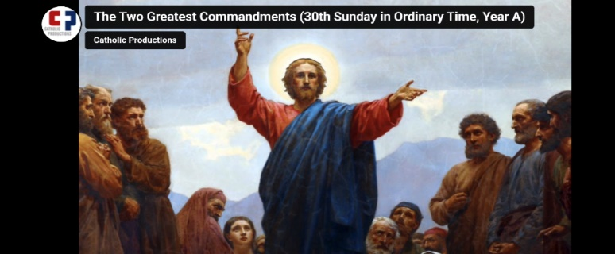
Closing Prayer

Slide 12
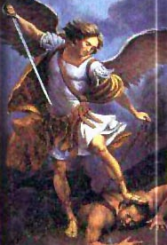
Prayer to St. Michael Archangel
St. Michael the Archangel, defend us in battle. Be our protection against the wickedness and snares of the Devil. May God rebuke him, we humbly pray. And do thou, O Prince of the heavenly hosts, by the power of God, cast into hell Satan, and all the evil spirits, who prowl about the world seeking the ruin of souls. Amen.

Slide 13
“AI” In Hollywood
War Games
https://www.youtube.com/watch?v=s93KC4AGKnY (1:34)
The Terminator
https://www.youtube.com/watch?v=4DQsG3TKQ0I
I Robot
https://www.youtube.com/watch?v=05bGPiyM4jg
Tesla robots
https://www.youtube.com/watch?v=cpraXaw7dyc
https://www.youtube.com/watch?v=ZTrebszENNw
https://www.youtube.com/watch?v=T6KtiOmRkn8 (1:02)

Slide 14
Resources
https://www.youtube.com/watch?v=8u4SeFnY9Jc&t=283s
https://www.youtube.com/watch?v=Wjrdr0NU4Sk

